Slide 1

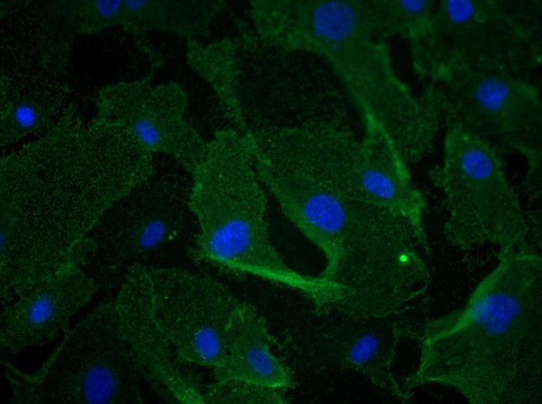
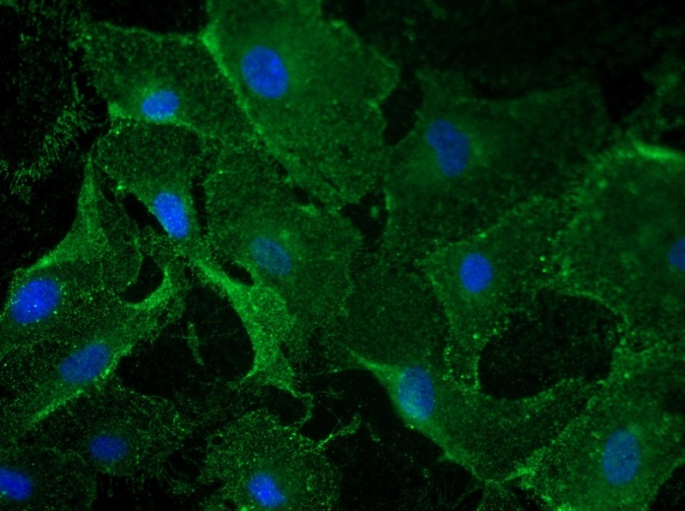
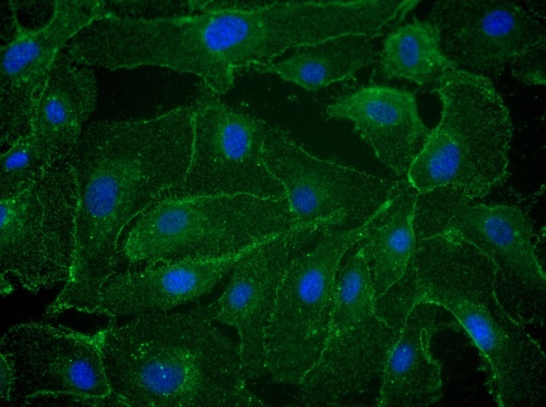
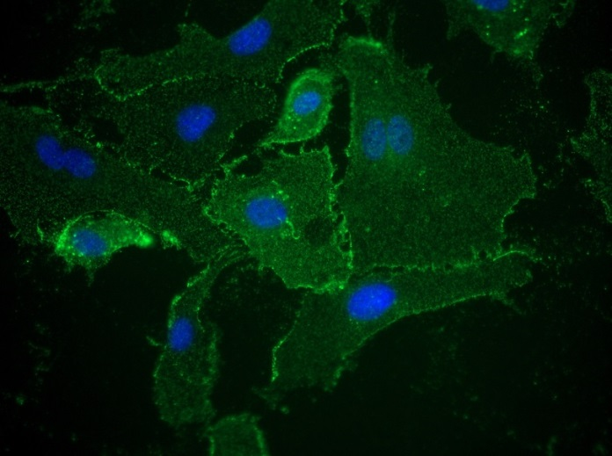
Reliatech GmbH
Rabbit anti-human NRP-1 and rabbit anti-human ESAM-1
(Cat# 102-PA23; #102-PA42)
Immunofluorescence staining of human Neuropilin-1 (NRP-1) and human ESAM-1 in primary human umbilical vein endothelial cells (HUVEC) using a polyclonal rabbit anti-human NRP-1 (#102-PA23) and ESAM-1 (#102-PA42) antibody.
As secondary goat anti-rabbit ALEXA Flour 488 (Dianova) was used 1:800.
[IF_HU1402-09]
.
NRP-1: #102-PA23 (2µg/ml)
NRP-1: #102-PA23 (10µg/ml)
ESAM-1: #102-PA42 (2µg/ml)
ESAM-1: #102-PA42 (10µg/ml)
http://www.reliatech.de / orders@reliatech.de
Sec. AB: goat anti-rabbit ALEXA Flour 488 (1:800)

